Slide 1

Fuzzy-Genetic Hybrid Models
for Large-Horizon
Deterministic Planning
Final Master’s Project
Mark Safrónov
10th September 2025

Slide 2
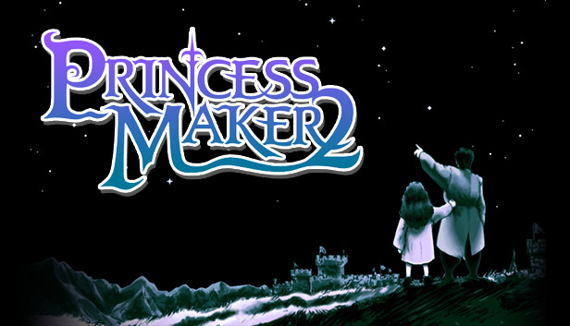
Princess Maker 2 — where it all started

Slide 3
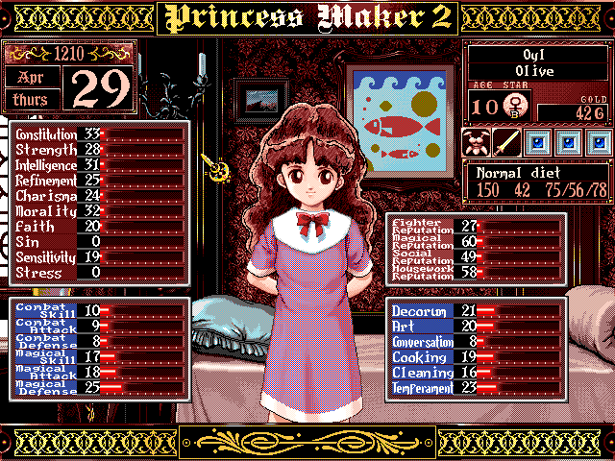
Princess Maker 2 — scale
22 numeric attributes

Slide 4
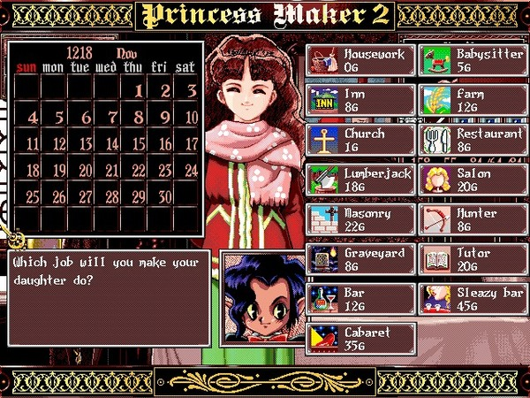
Princess Maker 2 — scale
25 actions
each changes 2+ attributes

Slide 5

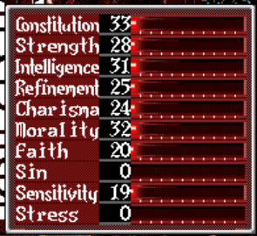
Princess Maker 2 — scale
25 actions
each changes 2+ attributes
+1
+1
+1
-2

Slide 6

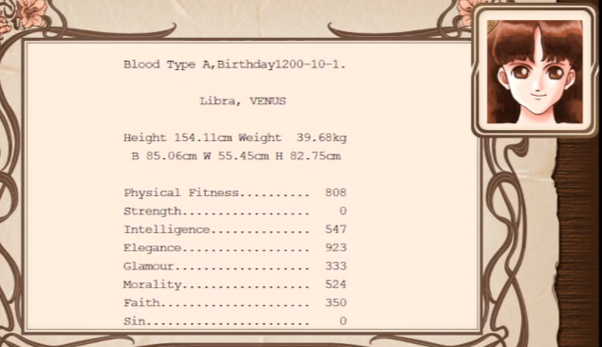
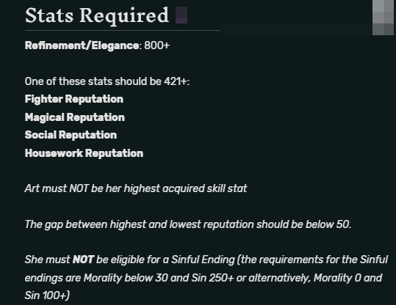
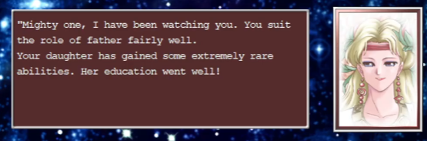
Princess Maker 2 — endings
61 ending each having its own requirements to meet
Example: Queen ending

Slide 7
Can we solve that?

Slide 8
From the game to a CS problem
Problem: given an ending we want, can we deduce a list of actions to reach this ending?

Slide 9
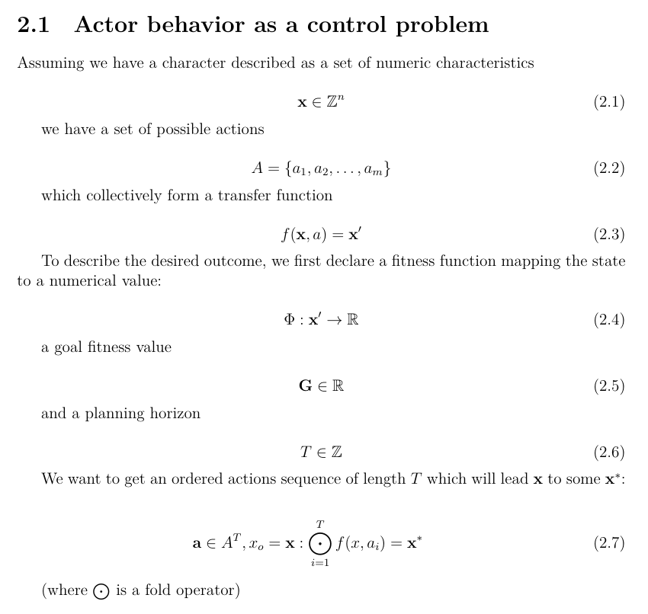

From the game to a CS problem
One-page definition of the problem
Deterministic planning problem with the fixed-length actions sequence

Slide 10
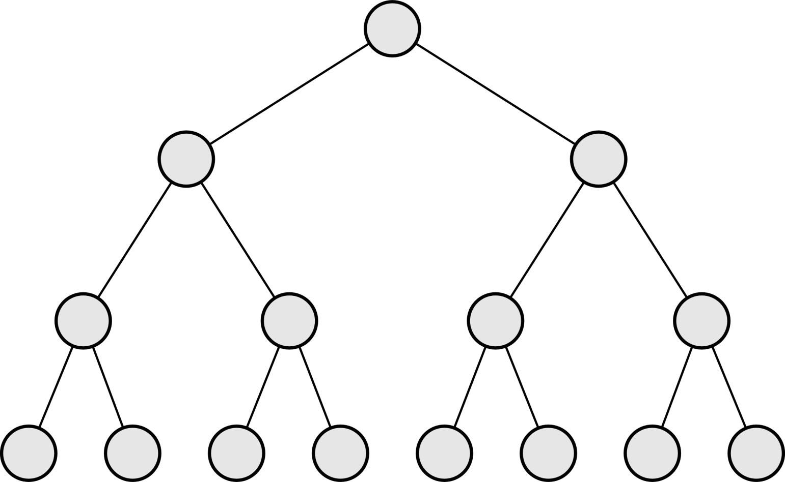
The problem of scale
Every fan-out is 25 options not 2
Depth of the tree is 360+ steps, depending on how do we interpret scheduling
Bruteforce enumeration is intractable, what are our other options?

Slide 11
Option 1: Automatic planning
Courtesy of Dr. Hatem Abdelatiff.
There exist ready-made solutions based on STRIPS formalism in the PDDL syntax.
Solver like ENHSP can work with numeric states and goals.
It will not work for us because we must have fixed length plans — defining a cost function to enforce this is nontrivial if possible at all.

Slide 12
Option 2: Reinforcement learning
Courtesy of Dr. Jordi Duch.
«Stateful actor learns to perform sequences of state-changing actions to reach predefined goals»
It will not work for us because of a scale and delayed evaluation — after 360...1200th step the signal will be negligible.

Slide 13
Treat the problem as a control problem
What if I treat every trajectory as a control problem.
Then I need only to invent a way to influence the decisions in that single trajectory, and optimise on this «way»

Slide 14







Clustering using domain knowledge
«Inclinations»
Fighting Magic Artistry Housekeeping Sinfulness
Lumberjack,
Combat classes,
etc
Cabaret
etc
Magic classes,
Graveyard
etc
Innkeeping,
Theology
etc
Dance classes,
Tutoring
etc

Slide 15
Single trajectory
5 inclination values + current state at step n controls the priorities of actions
Selected highest-priority action changes the current state
Repeating T times gives us a trajectory and a final state
Evaluate the final state (whether we are at a goal)

Slide 16
Optimization
5 inclination values effectively define the final fitness
We have a pure function to argmin

Slide 17
Chosen approaches
Inclinations + current state must map to action priorities: fuzzy logic
We must optimize inclinations to minimize fitness: evolutionary computations
(minimize not maximize fitness is a technical detail)

Slide 18
Fuzzy logic
«low»: 0.15, «high»: 0.65
«low»: 0.12, «high»: 0.67
Lumberjack priority «high»: 0.1, «low»: 0.1
Lumberjack priority: 0.11
(just an example, depends on the defuzzification)

Slide 19
Evolutionary computations
5 inclinations: vector (I1, I2, I3, I4, I5) — «genome»
Generate N random genomes — «population»
For every genome, calculate their fitness.
Apply special evolution-inspired «crossover», «mutation», «selection» and «replacement» operators to the population
Repeat. If your selection and replacement are sound, computation converges.

Slide 20
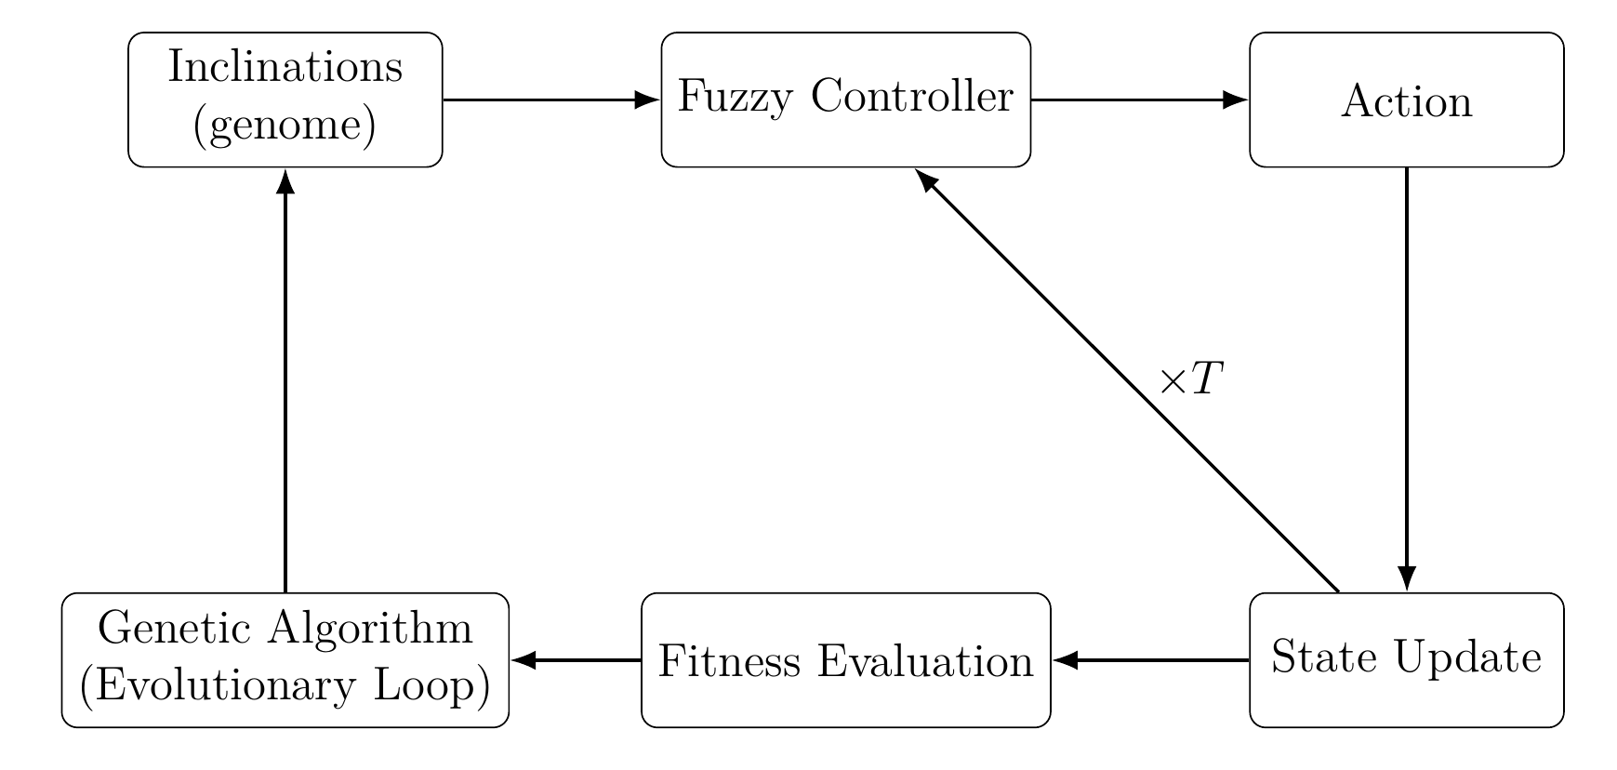
Control flow scheme

Slide 21
GOALS
1. Build a proof-of-concept
2. Ensure it actually produces solutions (fitness = 0)
3. Estimate performance
4. Summarize potential problems and possible future research

Slide 22
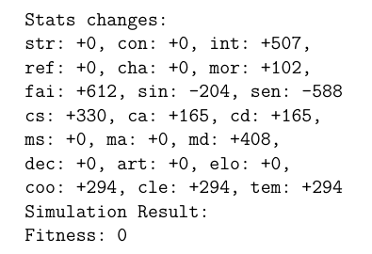
Baseline experiment setup
Number of character attributes: 21
Number of actions: 25
Length of actions sequence: 1200
Complex goal predicate based on the actual game («High General ending»)
Result:

Slide 23
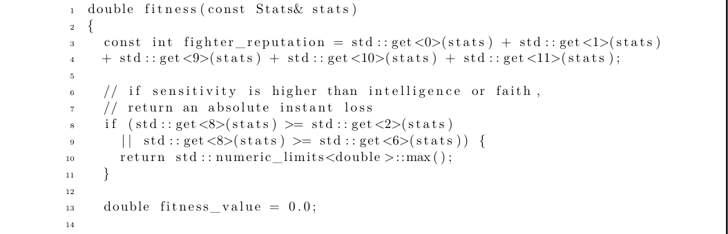
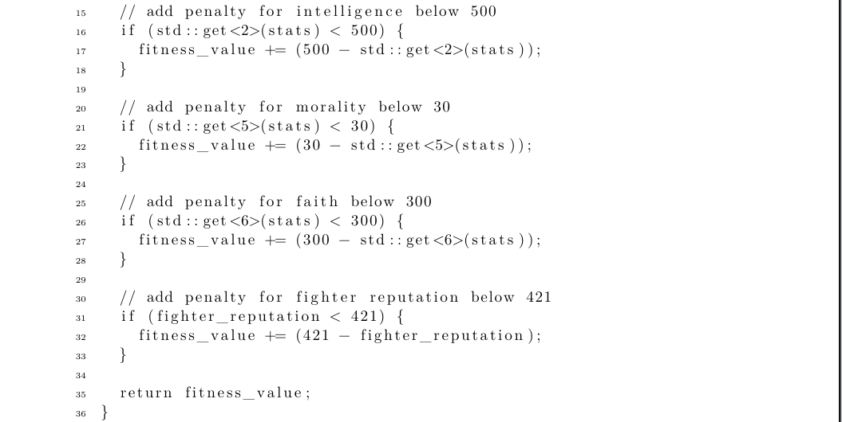
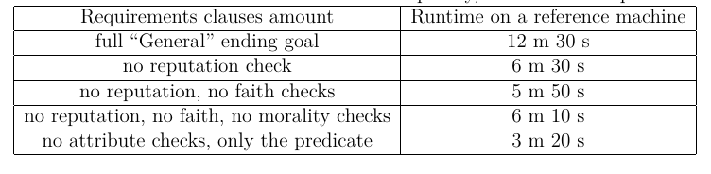
RESULTS
Linear time on T, depends only on the complexity of the goal predicate

Slide 24
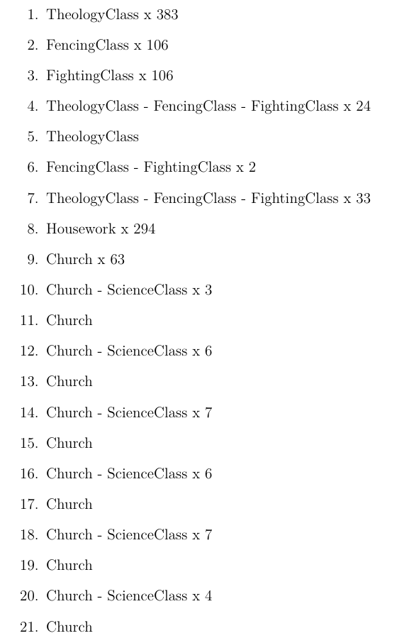
RESULTS
Result coming out of the solver is a vector of inclinations (5 real numbers in our setup).
Because the problem is formulated completely deterministic, we can effectively decode the sequence of actions out of these inclination values.
As such, our proof-of-concept deduces action sequences of fitness 0 → our goals are reached.

Slide 25
Conclusions
A generic problem has been formulated and a proof-of-concept solver has been built for it.
We successfully utilized domain knowledge to reduce dimensionality of the original problem.
On the given instance of a problem the solver reaches linear time over length of action sequence T. Complexity of the goal predicate significantly influences the runtime.
Still yet to research the dependence on number of actions and number of attributes.
Still yet to compare with the reference possible implementations of solvers using ENHSP and reinforcement learning.

Slide 26
Thank you for listening

